Slide 1
Web Programming (20CS5205A)

Slide 2
UNIT-III
JavaScript
DHTML
XML

Slide 3
Overview of Java Script
A number of Technologies are present that develops the static web page, but we require a language that is dynamic in nature to develop web pages.
JavaScript was created by Brendan Eich in 1995 at Netscape Communications.
JavaScript was the first client-side scripting language developed by Netscape.
JavaScript made its first appearance in Netscape 2.0 in 1995 with the name LiveScript.

Slide 4
JavaScript is an object-based client-side scripting language that is popular and used to create dynamic and interactive web pages.
Javascript is an interpreted language usually used with HTML, and programs written in JavaScript are called lightweight scripts.
JavaScript is a simple language which is only suitable for simple tasks.

Slide 5
Features:
JavaScript is a lightweight, interpreted programming language.
Designed for creating network-centric applications.
Complementary to and integrated with Java.
Complementary to and integrated with HTML.
Open and cross-platform

Slide 6
Java Script example program:
<html>
<head>
</head>
<body>
<script type = "text/javascript">
document. write("Hello World") ;
</script>
<p>This is web page body </p>
</body>
</html>

Slide 7
JavaScript variables
variables are containers for storing data (storing data values).
4 Ways to Declare a JavaScript Variable:
Using var
Using let
Using const
Using nothing

Slide 8
When to Use JavaScript var?
Always declare JavaScript variables with var,let, or const.
The var keyword is used in all JavaScript code from 1995 to 2015.
The let and const keywords were added to JavaScript in 2015.
If you want your code to run in older browsers, you must use var.

Slide 9
Java Script Function:
A function is a group of reusable code which can be called anywhere in your program.
JavaScript also supports all the features necessary to write modular code using functions.
The basic syntax
<script type = "text/javascript">
<!–
function functionname(parameter-list) { statements }
//-->
</script>

Slide 10
Example program:
<html>
<body>
<script type = "text/javascript">
function sayHello()
{
document.write ("Hello….!");
document.write (“Welcome to Java Script!");}
sayHello();
</script>
</body>
</html>

Slide 11
Calling a Function:
<html>
<head>
<script type = "text/javascript">
function sayHello()
{ document.write ("Hello there!");
}
</script>
</head> <body>
<p>Click the following button to call the function</p>
<form>
<input type = "button" onclick = "sayHello()" value = "Say Hello">
</form> </body> </html>

Slide 12
JavaScript conditional statemenst :
Conditional statements are used to decide the flow of execution based on different conditions. If a condition is true, you can perform one action and if the condition is false, you can perform another action.
There are mainly three types of conditional statements
If statement
If…else statement
If…else If…else statement

Slide 13
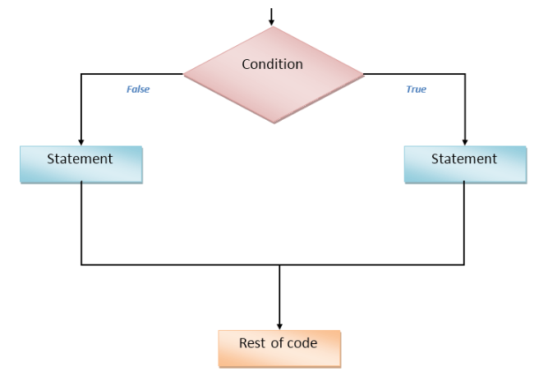

Slide 14
if statement
The if statement is the fundamental control statement that allows JavaScript to make decisions and execute statements conditionally.
Syntax
if (expression)
{
//Statement(s) to be executed if expression is true
}

Slide 15
if...else statement
The 'if...else' statement is the next form of control statement that allows JavaScript to execute statements in a more controlled way.
Syntax
if (expression)
{ Statement(s) to be executed if expression is true
}
else
{ Statement(s) to be executed if expression is false
}

Slide 16
if...else if... statement
The if...else if... statement is an advanced form of if…else that allows JavaScript to make a correct decision out of several conditions.
Syntax
if (expression 1)
{ Statement(s) to be executed if expression 1 is true }
else if (expression 2)
{ Statement(s) to be executed if expression 2 is true }
else if (expression 3)
{ Statement(s) to be executed if expression 3 is true }
else { Statement(s) to be executed if no expression is true }

Slide 17
JavaScript Switch Statement
The switch statement is used to perform different actions based on different conditions.
switch(expression) { case x: // code block break; case y: // code block break; default: // code block }

Slide 18
JavaScript Loops
The JavaScript loops are used to iterate the piece of code using for, while, do while or for-in loops. It makes the code compact. It is mostly used in array.
There are four types of loops in JavaScript.
for loop
while loop
do-while loop
for-in loop

Slide 19
JavaScript For loop
The JavaScript for loop iterates the elements for the fixed number of times. It should be used if number of iteration is known. The syntax of for loop is given below.
for (initialization; condition; increment)
{
code to be executed
}

Slide 20
JavaScript while loop
The JavaScript while loop iterates the elements for the infinite number of times. It should be used if number of iteration is not known. The syntax of while loop is given below.
while (condition)
{
code to be executed
}

Slide 21
JavaScript do while loop
The JavaScript do while loop iterates the elements for the infinite number of times like while loop. But, code is executed at least once whether condition is true or false.
The syntax :
do{
code to be executed
}while (condition);

Slide 22
for...in statement
The for...in statement iterates a specified variable over all the enumerable properties of an object.
For each distinct property, JavaScript executes the specified statements.
statement looks as follows:
for (key in object)
{
// body of for...in
}

Slide 23
<script type = "text/javascript">
const student =
{
name: 'komali',
class: 7,
age: 12
}
for ( let key in student )
{
document.write(`${key} => ${student[key]}`);
document.write("<br>");
}
</script>

Slide 24
pop-up boxes in JavaScript
In Javascript, popup boxes are used to display the message or notification to the user.
There are three types of pop-up boxes in JavaScript namely
Alert Box,
Confirm Box and
Prompt Box.

Slide 25
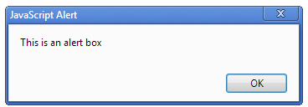
Alert Box
Alert Box is the Java script message box that inform or alert the user by displaying some messages in a small dialogue box
Syntax:
alert(string)
Whenever an alert box pops up, the user will have to click "OK" button to proceed to next step

Slide 26
Alert ():
<html>
<body>
<script type="text/javascript">
function msg()
{
alert("Hello Alert Box");
}
</script>
<input type="button" value="click" onclick="msg()"/>
</body>
</html>

Slide 27
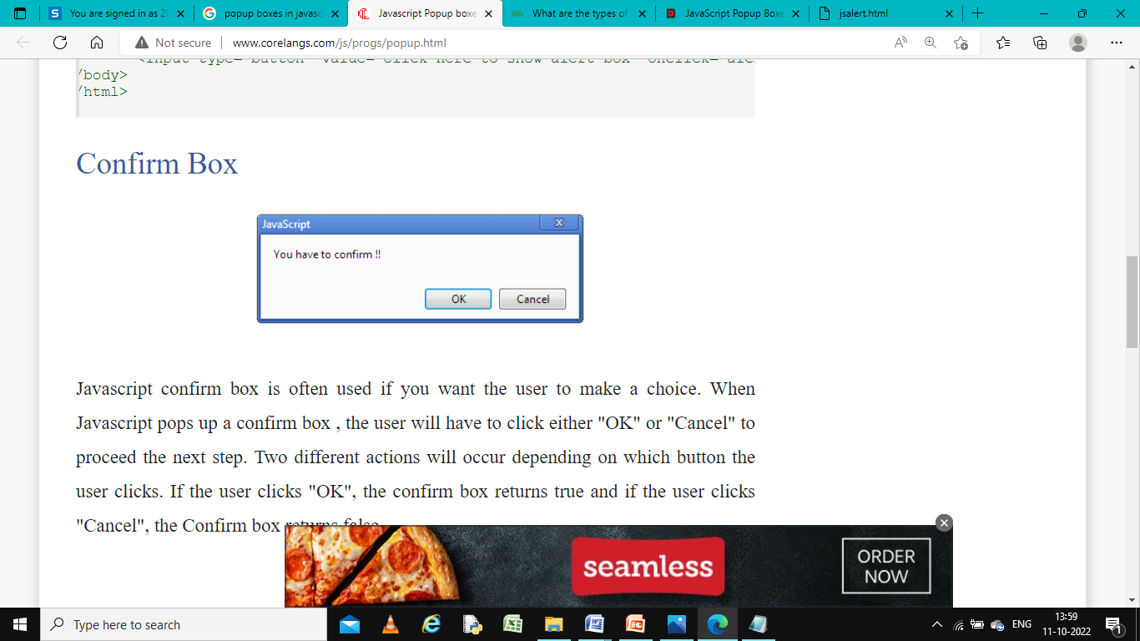
Confirm Box:
Javascript confirm box is often used if you want the user to make a choice. When Java script pops up a confirm box , the user will have to click either "OK" or "Cancel" to proceed the next step.
Two different actions will occur depending on which button the user clicks. If the user clicks "OK", the confirm box returns true and if the user clicks "Cancel", the Confirm box returns false
Syntax:
confirm(string)

Slide 28
Confirm():
<!DOCTYPE html>
<html>
<body>
<p>Click the button to display a confirm box.</p>
<button onclick="myFunction()">Try it</button>
<script>
function myFunction() {
confirm("Press a button!");
}
</script></body> </html>

Slide 29
Prompt Box:
Java script Prompt Box is often used if you want the user to enter an input value before proceed to the next step.
When Java script display prompt box , the user will have to click either "OK" or "Cancel" to proceed after entering an input value.
If the user clicks "OK" the box returns the input value and if the user clicks "Cancel" the box returns null

Slide 30
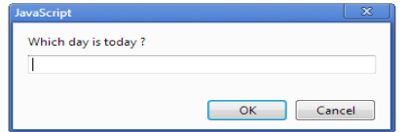
Syntax:
prompt(“text goes here”, “default value”);

Slide 31
prompt():
<html>
<head>
<script type = "text/javascript">
function getValue() {
var Val = prompt("Enter your name : ", "your name here");
document.write(“welcome: " + Val);
}
</script> </head> <body>
<p>Click the following button to see the result: </p>
<form>
<input type = "button" value = "Click Me" onclick = "getValue();" />
</form> </body> </html>

Slide 32
Advance JavaScript
JavaScript Objects
A java Script object is an entity having state and behavior (properties and method).
JavaScript is an object-based language. Everything is an object in JavaScript.
JavaScript is template based not class based. Here, we don't create class to get the object. But, we direct create objects
JavaScript has several built-in objects, like String, Date, Array, and more.

Slide 33
Creating a JavaScript Object
With JavaScript, you can define and create your own objects.
There are different ways to create new objects:
By object literal
By creating instance of Object directly (using new keyword)
By using an object constructor (using new keyword)

Slide 34
By object literal
This is the easiest way to create a JavaScript Object.
Using an object literal, you both define and create an object in one statement.
An object literal is a list of name:value pairs (like age:50) inside curly braces {}.
Syntax:
object={property1:value1,property2:value2.....propertyN:valueN}
Example:
const person = {firstName:"John", lastName:"Doe", age:50, eyeColor:"blue"};

Slide 35
This example creates an empty JavaScript object, and then adds 4 properties:
Example
const person = {}; person.firstName = "John"; person.lastName = "Doe"; person.age = 50; person.eyeColor = "blue"

Slide 36
By creating instance of Object
The syntax of creating object directly is given below:
var objectname=new Object();
Here, new keyword is used to create object.
example :
var emp=new Object();
emp.id=101;
emp.name="Ravi Malik";
emp.salary=50000;

Slide 37
By using an Object constructor
First you need to create function with arguments. Each argument value can be assigned in the current object by using this keyword.
function emp(id,name,salary)
{
this.id=id;
this.name=name;
this.salary=salary;
}
e=new emp(103,"Vimal Jaiswal",30000);

Slide 38
Defining method in JavaScript Object
We can define method in JavaScript object. But before defining method, we need to add property in the function with same name as method.

Slide 39
JavaScript Object Methods
Methods | Description
Object.assign() | This method is used to copy enumerable and own properties from a source object to a target object
Object.create() | This method is used to create a new object with the specified prototype object and properties.
Object.getOwnPropertyDescriptors() | This method returns all own property descriptors of a given object.
Object.getOwnPropertyNames() | This method returns an array of all properties (enumerable or not) found.
Object.getOwnPropertySymbols() | This method returns an array of all own symbol key properties.
Object.getPrototypeOf() | This method returns the prototype of the specified object.

Slide 40
Object.is() | This method determines whether two values are the same value.
Object.isExtensible() | This method determines if an object is extensible
Object.keys() | This method returns an array of a given object's own property names.
Object.values() | This method returns an array of values

Slide 41
JavaScript own objects
JavaScript supports a number of built-in objects that extend the flexibility of the language.
These objects are Date, Math, String, Array, and Object.
Several of these objects are "borrowed" from the Java language specification, but JavaScript's implementation of them is different.

Slide 42
Understanding the string object
the String object is the most commonly used. In the Netscape 2.0 JavaScript implementation, new string objects are created implicitly using a variable assignment.
For example,
var myString = "This is a string";

Slide 43
String Properties
length | The length of a string
String Methods
anchor | Creates a named anchor (hypertext target)
big | Sets text to big
blink | Sets text to blinking
bold | Sets text to bold
charAt | Returns the character at a specified position
fixed | Sets text in fixed-pitch font
fontcolor | Sets the font color
fontsize | Sets font size
indexOf | Returns the first occurrence of character x starting from position y
italics | Sets text to italics
lastIndexOf | Returns the last occurrence of character x starting from position y

Slide 44
link | Creates a hyperlink
small | Sets text to small
strike | Sets text to strikeout
sub | Sets text to subscript
substring | Returns a portion of a string
sup | Sets text to superscript
toLowerString | Converts a string to lowercase
toUpperString | Converts a string to uppercase

Slide 45
Math Object:
JavaScript's Math object provides advanced arithmetic and trigonometric functions, expanding on JavaScript's basic arithmetic operators (plus, minus, multiply, divide).
The Math object in JavaScript is borrowed from Java
The Math object is static, so you don't need to create a new Math object in order to use it. To access the properties and method of the Math object, you merely specify the Math object, along with the method or property you wish

Slide 46
Example:
var pi = Math.PI;
var pieAreRound = Math.round(pi);

Slide 47
Math Properties
E | Euler's constant
LN2 | The natural logarithm of 2
LN10 | The natural logarithm of 10
LOG2E | The base 2 logarithm of e
LOG10E | The base 10 logarithm of e
PI | The numeric equivalent of PI: 3.14 etc.
SQRT1_2 | The square root of one-half
SQRT2 | The square root of 2

Slide 48
Math Methods
abs | Returns the absolute value of a number
ceil | Returns the least integer greater than or equal to a number
cos | Returns the cosine of a number
exp | Returns e (Euler's constant) to the power of a number
floor | Returns the greatest integer less than or equal to its argument
log | Returns the natural logarithm (base e) of a number
max | Returns the greater of two values
min | Returns the lesser of two values
pow | Returns the value of a number times a specified power
random | Returns a random number (X-platforms only)
round | Returns a number rounded to the nearest whole value
sqrt | Returns the square root of a number

Slide 49
Date Object
Date object can be used in JavaScript to determine the current time and date.
A popular JavaScript application of the Date object is displaying a digital clock in a text box.
The script uses the Date object to update the clock once every second.
JavaScript treats the Date object like a constructor class.
To use Date you must create a new Date object; you can then apply the various Date methods to get and set dates. (The Date object has no properties.)

Slide 50
getHours() - Returns the hour
getMinutes() - Returns the minutes
getSeconds() - Returns the seconds
getYear() - Returns the year ("96" is 1996)
getMonth() - Returns the month ("0" is January)
getDate() - Returns the day of the month
getDay() - Returns the day of the week ("0" is Sunday)
Examples:
var now = new Date(); var yearNow = now.getYear();

Slide 51
JavaScript Array
In JavaScript, an array is an ordered list of values. Each value is called an element specified by an index
An array can hold values of mixed types.an array that stores elements with the types number, string, Boolean, and null.
the size of an array is dynamic and auto-growing.
There are 3 ways to construct array in JavaScript
By array literal
By creating instance of Array directly (using new keyword)
By using an Array constructor (using new keyword)

Slide 52
1. JavaScript array literal
syntax
var arrayname=[value1,value2.....valueN];
Example:
var emp=["Sonoo","Vimal","Ratan“,1,2,3,4];
for (i=0;i<emp.length;i++)
{
document.write(emp[i] + "<br/>");
}

Slide 53
2. JavaScript Array directly (new keyword)
The syntax of creating array directly is given below:
var arrayname=new Array(); //Here, new keyword is used to create instance of array.
Example:
var i;
var emp = new Array();
emp[0] = "Arun";
emp[1] = "Varun";
emp[2] = "John";
for (i=0;i<emp.length;i++)
{
document.write(emp[i] + "<br>");
}

Slide 54
3. JavaScript array constructor (new keyword)
Here, you need to create instance of array by passing arguments in constructor so that we don't have to provide value explicitly
Example:
var emp=new Array("Jai","Vijay",“Ajay");
for (i=0;i<emp.length;i++)
{
document.write(emp[i] + "<br>");
}

Slide 55
Basic operations on arrays
1.Adding an element to the end of an array
2. Adding an element to the beginning of an array
3. Removing an element from the end of an array
4. Removing an element from the beginning of an array
5. Removing an element from the beginning of an array
6. Check if a value is an array
7.Retriving part of an array.(slice)

Slide 56
Methods
push() – Insert an element at the end of the array.
unshift() – Insert an element at the beginning of the array.
pop() – Remove an element from the end of the array.
shift() – Remove an element from the end of the array.
slice() – Create a shallow copy of an array.
Array.isArray() – Determine if a value is an array.
length – Determine the size of an array

Slide 57
Slice()
The slice() method cuts the array and returns a shallow copy of a portion of an array into a new array object
It takes in two parameters: begin and end. The array is sliced from the index specified as begin till the end index (end index excluded).
The original array will not be modified.
If the end parameter is unspecified, the entire array from the begin index is sliced.

Slide 58
Loop Over the Array Items
You can also loop over an array in case you need to access multiple elements from the array at once.
We use the forEach method for this, which calls a function once for each element in an array.
Example:
const fruits = ["apple", "orange", "cherry"]; fruits.forEach(myFunction);

Slide 59
DOM and web browser environments
When a web page is loaded, the browser create a Document Object Model of the page.
with the object model, JavaScript gets all the power it needs to create dynamic HTML:
JavaScript can change all the HTML elements in the page
JavaScript can change all the HTML attributes in the page
JavaScript can change all the CSS styles in the page
JavaScript can remove existing HTML elements and attributes
JavaScript can add new HTML elements and attributes
JavaScript can react to all existing HTML events in the page
JavaScript can create new HTML events in the page

Slide 60
JavaScript HTML DOM
The Document Object Model (DOM) is a programming interface for and XML(Extensible markup language) documents.
It defines the logical structure of documents and the way a document is accessed and manipulated.
The DOM is a W3C (World Wide Web Consortium) standard.
The DOM defines a standard for accessing documents
"The W3C Document Object Model (DOM) is a platform and language-neutral interface that allows programs and scripts to dynamically access and update the content, structure, and style of a document.“

Slide 61
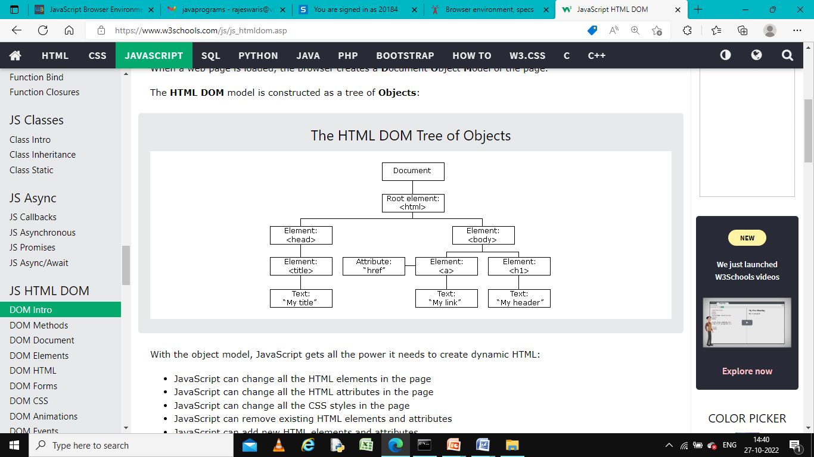
JavaScript HTML DOM

Slide 62
The DOM Programming Interface
The HTML DOM can be accessed with JavaScript (and with other programming languages).
In the DOM, all HTML elements are defined as objects.
A property is a value that you can get or set (like changing the content of an HTML element).
A method is an action you can do (like add or deleting an HTML element).

Slide 63
Example:
<!DOCTYPE html>
<html>
<body>
<h2>My First Page</h2>
<p id="demo"></p>
<script>
document.getElementById("demo").innerHTML = "Hello World!";
</script>
</body>
</html>

Slide 64
Window
The window is the browser tab that a web page is loaded into; this is represented in JavaScript by the Window object.
Using methods available on this object you can know the window's size
1.Window.innerWidth
2.Window.innerHeight

Slide 65
Navigator
The navigator represents the state and identity of the browser (i.e. the user-agent) as it exists on the web.
In JavaScript, this is represented by the Navigator object.
You can use this object to retrieve things like the user's preferred language, a media stream from the user's webcam, etc.

Slide 66
Document
The document (represented by the DOM in browsers) is the actual page loaded into the window, and is represented in JavaScript by the Document object.
You can use this object to return and manipulate information on the HTML and CSS.

Slide 67
Manipulation using DOM
When writing web pages and apps, one of the most common things you'll want to do is manipulate the document structure in some way.
This is usually done by using the Document Object Model (DOM), a set of APIs for controlling HTML and styling information that makes heavy use of the Document object.

Slide 68
Some JavaScript DOM selectors are:
getElementById() – Here, selection is based on the id name. This selector returns only the first matched element.
getElementByClassName() – This method returns all elements that match a specified class name.
getElementByTagName() – This method returns all the elements that match a specific tag name.
querySelector() – This method returns the first element that matches a specific CSS selector in the document.
querySelectorAll() – It returns all elements that match the specified css selector in the document.

Slide 69
Example:
<html>
<body>
<div id = "test"> Hello world </div>
<script >
document.getElementById("test");
//styling the accessed element
document.getElementById('test').style.color = "pink";
</script>
</body>
</html>

Slide 70
forms and validations
JavaScript Form Validation
Before submitting data to the server, it is important to ensure all required form controls are filled out, in the correct format.
This is called client-side form validation, and helps ensure data submitted matches the requirements set forth in the various form controls
HTML form validation can be done by JavaScript.

Slide 71
If a form field (fname) is empty, this function alerts a message, and returns false, to prevent the form from being submitted
Example:
function validateForm()
{ let x = document.forms["myForm"]["fname"].value; if (x == "") { alert("Name must be filled out"); return false; } }

Slide 72
Data Validation
Data validation is the process of ensuring that user input is clean, correct, and useful. validation tasks are:
has the user filled in all required fields?
has the user entered a valid date?
has the user entered text in a numeric field?

Slide 73
the purpose of data validation is to ensure correct user input.
Validation can be defined by many different methods, and deployed in many different ways.
Server side validation is performed by a web server, after input has been sent to the server.
Client side validation is performed by a web browser, before input is sent to a web server.

Slide 74
<html> <head> <script type="text/javascript">
function printvalue()
{
var name=document.form1.uname.value;
document.writeln("Your Name:"+name);//alert("Welcome: "+name);
}
</script>
<form name="form1">
Enter Name:<input type="text" name=“uname"/>
<input type="button" onclick="printvalue()" value="PRINT VALUE"/>
</form>
</body> </html>

Slide 75
DHTML
DHTML stands for Dynamic Hypertext Markup language i.e. Dynamic HTML.
Dynamic HTML is not a markup or programming language but it is a term that combines the features of various web development technologies for creating the web pages dynamic and interactive.
Web pages may include animation, dynamic menus and text effects.
The technologies includes combination of HTML, JavaScript , CSS and DOM

Slide 76
Designed to enhance a Web user’s experience, DHTML includes the following features:
Dynamic content, which allows the user to dynamically change Web page content.
Dynamic positioning of Web page elements
Dynamic style, which allows the user to change the Web page’s color, font, size or content

Slide 77
HTML (Hypertext Markup language) | DHTML (Dynamic Hypertext Markup language)
1. HTML is simply a markup language. | 1. DHTML is not a language, but it is a set of technologies of web development.
2. It is used for developing and creating web pages. | 2. It is used for creating and designing the animated and interactive web sites or pages.
3. This markup language creates static web pages. | 3. This concept creates dynamic web pages.
4. It does not contain any server-side scripting code. | 4. It may contain the code of server-side scripting.
5. The files of HTML are stored with the .html or .htm extension in a system. | 5. The files of DHTML are stored with the .dhtm extension in a system.
6. A simple page which is created by a user without using the scripts or styles called as an HTML page. | 6. A page which is created by a user using the HTML, CSS, DOM, and JavaScript technologies called a DHTML page.
7. This markup language does not need database connectivity. | 7. This concept needs database connectivity because it interacts with users.

Slide 78
Events and buttons.

Slide 79
Advantages of DHTML
Those web sites and web pages which are created using this concept are fast.
There is no plug-in required for creating the web page dynamically.
Due to the low-bandwidth effect by the dynamic HTML, the web page functionality is enhanced.
This concept provides advanced functionalities than the static HTML.
It is highly flexible, and the user can make changes easily in the web pages.

Slide 80
Disadvantages of DHTML
The scripts of DHTML does not run properly in various web browsers. It is only supported by the latest browsers.
The coding of those websites that are created using DHTML is long and complex.
For understanding the DHTML, users must know about HTML, CSS, and JavaScript. If any user does not know these languages, then it is a time-consuming and long process in itself.

